Slide 1
Day 19
Combining Noisy Measurements

Slide 2
Combining Noisy Measurements
suppose that you take a measurement x₁ of some real-valued quantity (distance, velocity, etc.)
your friend takes a second measurement x₂ of the same quantity
after comparing the measurements you find that
what is the best estimate of the true value μ?

Slide 3
Combining Noisy Measurements
suppose that an appropriate noise model for the measurements is where is zero-mean Gaussian noise with variance
because two different people are performing the measurements it might be reasonable to assume that x₁ and x₂ are independent

Slide 4
Combining Noisy Measurements
x = 5;
x1 = x + randn(1, 1000); % noise variance = 1
x2 = x + randn(1, 1000); % noise variance = 1
mu2 = (x1 + x2) / 2;
bins = 1:0.2:9;
hist(x1, bins);
hist(x2, bins);
hist(mu2, bins);

Slide 5
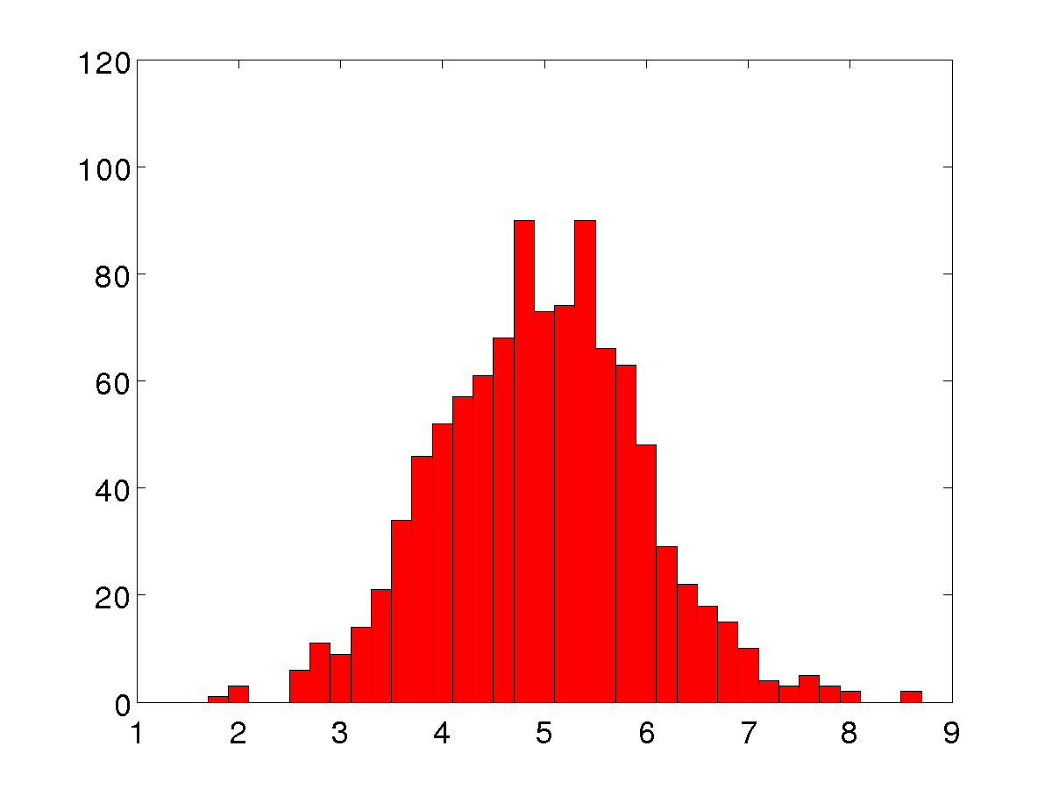
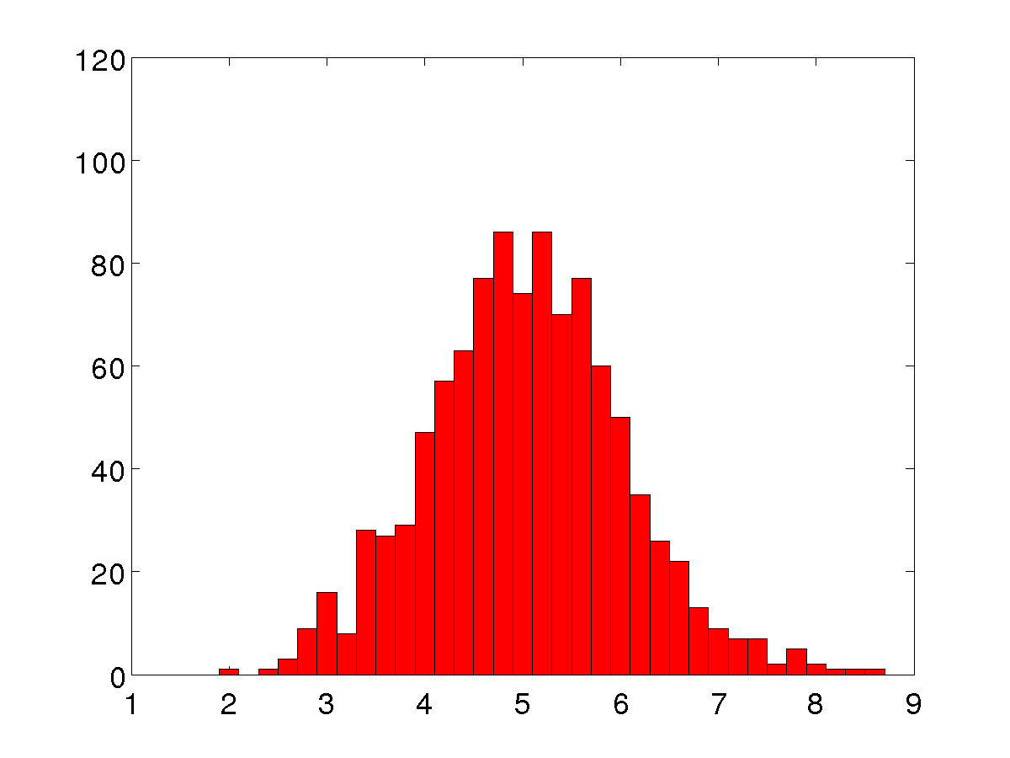
Combining Noisy Measurements
var(x1) = 0.9979
var(x2) = 0.9972

Slide 6
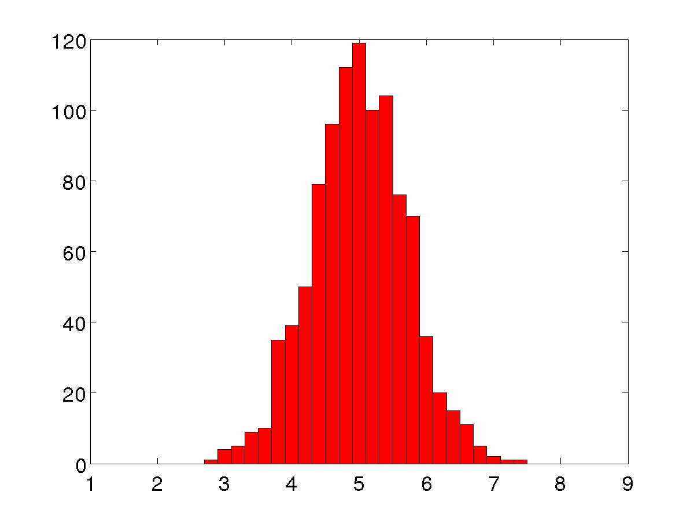
Combining Noisy Measurements
var(x1) = 0.4942

Slide 7
Combining Noisy Measurements
suppose the precision of your measurements is much worse than that of your friend
consider the measurement noise model where is zero-mean Gaussian noise with variance

Slide 8
Combining Noisy Measurements
x = 7;
x1 = x + 3 * randn(1, 1000); % noise variance = 3*3 = 9
x2 = x + randn(1, 1000); % noise variance = 1
mu2 = (x1 + x2) / 2;
bins = -2:0.2:18;
hist(x1, bins);
hist(x2, bins);
hist(mu2, bins);

Slide 9
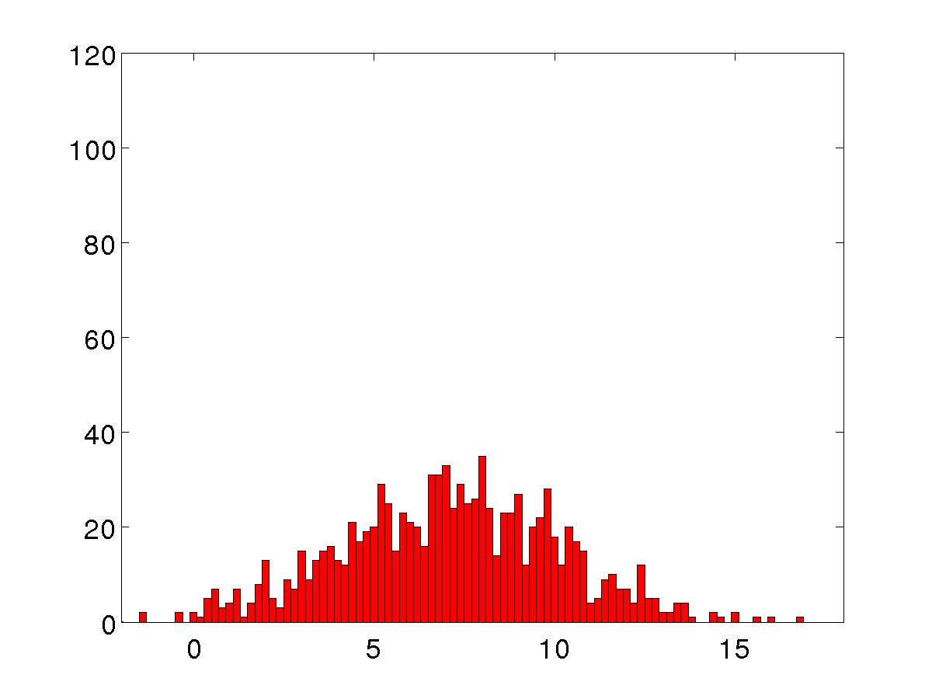
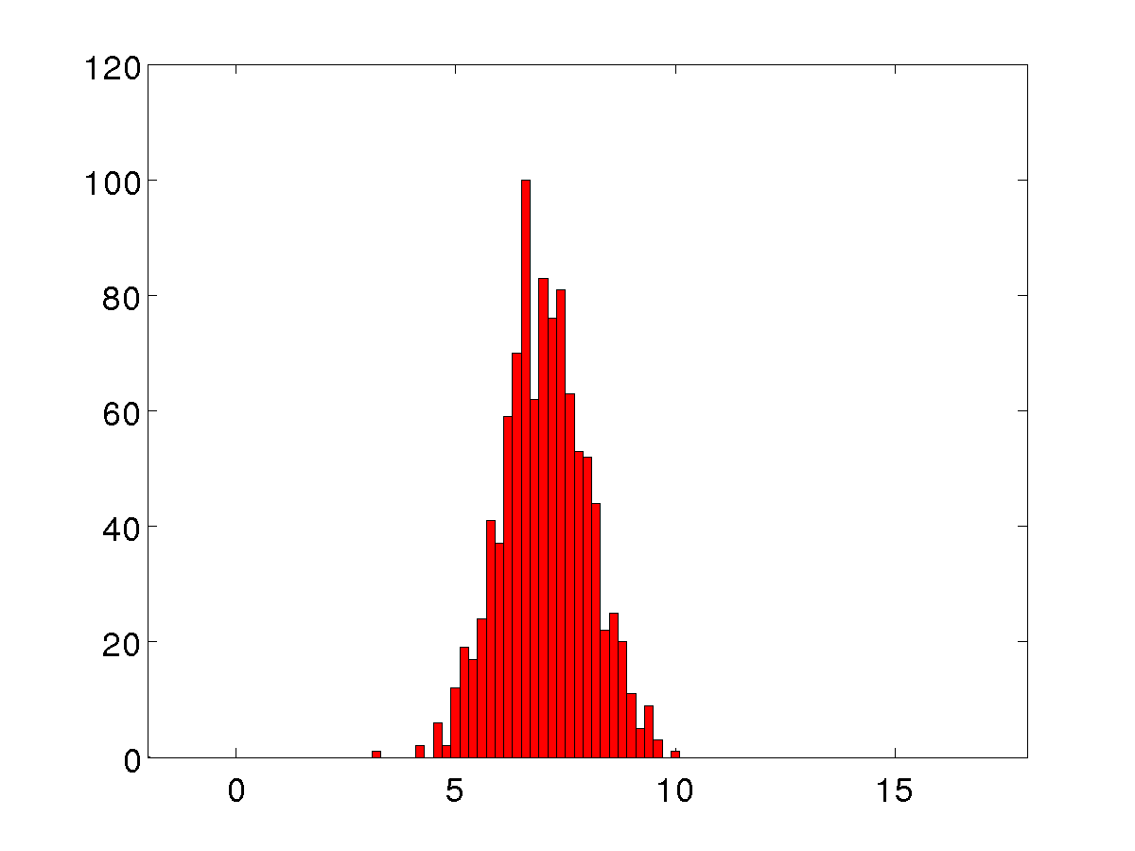
Combining Noisy Measurements
var(x1) = 8.9166
var(x2) = 0.9530

Slide 10
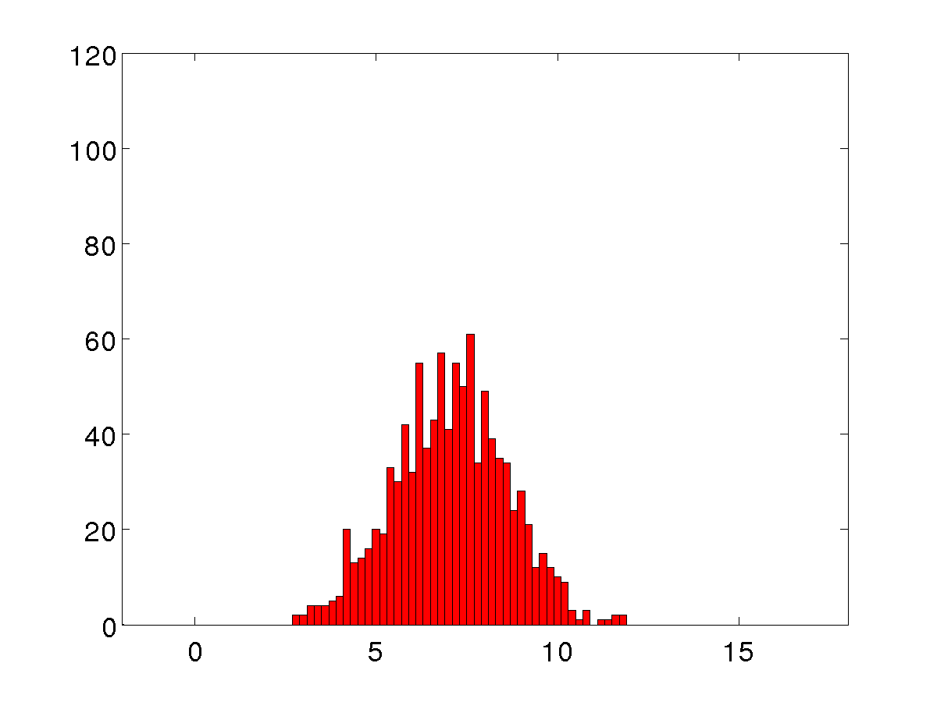
Combining Noisy Measurements
var(mu2) = 2.4317

Slide 11
Combining Noisy Measurements
is the average the optimal estimate of the combined measurements?

Slide 12
Combining Noisy Measurements
instead of ordinary averaging, consider a weighted average where
the variance of a random variable is defined as where E[X] is the expected value of X

Slide 13
Expected Value
informally, the expected value of a random variable X is the long-run average observed value of X
formally defined as
properties

Slide 14
Variance of Weighted Average

Slide 15
Variance of Weighted Average
because x₁ and x₂ are independent and are also independent; thus
finally

Slide 16
Variance of Weighted Average
because x₁ and x₂ are independent and are also independent; thus
finally

Slide 17
Variance of Weighted Average
one way to choose the weighting values is to choose the weights such that the variance is minimized

Slide 18
Minimum Variance Estimate
thus, the minimum variance estimate is

Slide 19
Combining Noisy Measurements
x = 7;
x1 = x + 3 * randn(1, 1000); % noise variance = 3*3 = 9
x2 = x + randn(1, 1000); % noise variance = 1
w = 9 / (9 + 1);
mu2 = (1 – w) * x1 + w * x2;
bins = -2:0.2:18;
hist(x1, bins);
hist(x2, bins);
hist(mu2, bins);

Slide 20
Minimum Variance Estimate
mu2=0.5*x1 + 0.5*x2
mu2=0.1*x1 + 0.9*x2
var(mu2) = 2.4317
var(mu2) = 0.8925

